Slide 1
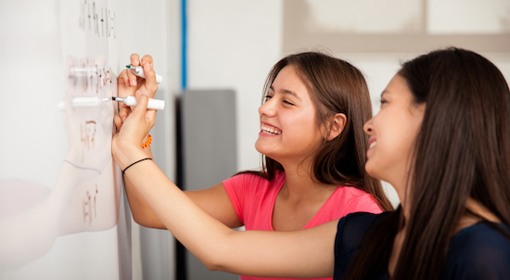
Problem Solving Session
The remainder of today’s class will comprise the problem solving session (PSS).
Your instructor will divide you into teams of 3 or 4 students.
Each team will work together to solve the following problems over the course of 20-30 minutes.
You may work on paper, a white board, or digitally as determined by your instructor.
You will submit your solution by pushing it to GitHub before the end of class.
Your instructor will go over the solution before the end of class.
If there is any time remaining, you will begin work on your homework assignment.
Class participation is a significant part of your grade (20%). This includes in class activities and the problem solving session.
Your Course Assistants will grade your participation by verifying that you pushed your solutions before the end of the class period each day.

Slide 2

Problem Solving Team Members
Record the name of each of your problem solving team members here.
Do not forget to add every team member’s name! Your instructor (or course assistant) may or may not use this to determine whether or not you participated in the problem solving session.

Slide 3
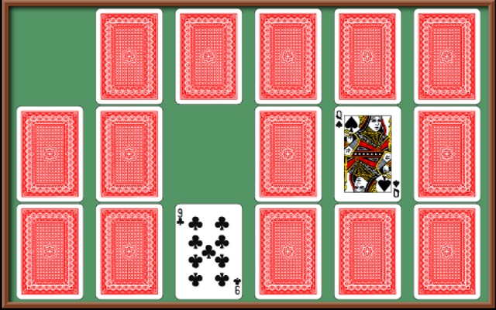
Memory
For your next assignment you will be implementing a text-based version of the classing matching game: Memory.
Cards are played face-down. The number of cards must be even, but is otherwise chosen by the player.
During each round of play, the player flips two cards so that they are face up.
If the cards match, they are removed from the board and the player earns a point.
If not, they are flipped face-down.
Play continues until all of the matches have been found.
The goal is to find all of the matches as quickly as possible.
The version of Memory that you implement will of course be text-based, but will also be fully playable.

Slide 4
Problem Solving 1
Assume that you are using tuples to represent cards in the format (rank, suit, name, shorthand), e.g. (2, "Hearts", "2 of Hearts", "H02").
In Memory, the cards must be flippable, meaning that they can be placed face-down or face-up. This is particularly important when displaying the board: cards will appear differently if they are face-down vs. face-up.
Solving the problem is not as simple as adding a 5th value to the card tuple because tuples are immutable, meaning that the values inside cannot be changed.
Discuss a possible solution with your team, and then write a function that, given a card tuple, will return a flippable version of that card. Note that all cards start face-down.

Slide 5
Problem Solving 2
A game of memory is played with a selection of cards in which there must be two of every card. Without this, there would be no way to find matches!
Write a function that, given a desired number of cards and a deck of cards, returns a list of the specific number of cards. The list should contain two of every card!
For example, if the number is 10, the list should contain 2 copies of each of 5 unique cards.

Slide 6
Problem Solving 3
At this point you should have a function that creates a flippable version of a playing card, and a function that can create a list of cards from a deck that you can use to play.
The next step is to build the board. Write a function that, given a number of rows and columns, will create a 2D board filled with the correct number of flippable cards.
You must use a 2D-array and you must use list comprehension in some way.

Slide 7
Problem Solving 4
The player must be aware of the current configuration of the board including:
Which cards are face-down.
Which cards have been removed.
Which cards are face-up (during a turn).
Write a function that will print the board. For now ignore the “removed” cards and focus only on cards that are face-up or face-down.
>> 2 2
2D [-] [-] [-] [-]
[-] [-] [-] [-] [-]
[-] [-] 2D [-] [-]
[-] [-] [-] [-] [-]

